Slide 1
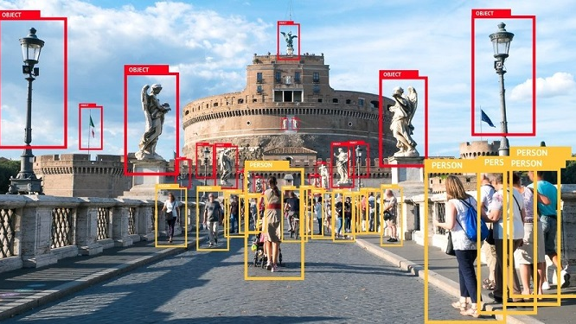
OBJECT DETECTION USING MACHINE LEARNING
Presented by-
Ayushman dutta

Slide 2

CONTENTS
INTRODUCTION
MACHINE LEARNING AND DEEPLEARNING
NEURAL NETWORKS
CONVOLUTIONAL NEURAL NETWORKS
YOLO ALGORITHM
IMPLEMENTATION
CONCLUSION AND FUTURE SCOPE

Slide 3
INTRODUCTION
Object detection is a computer technology related to computer vision and image processing that deals with detecting instances of semantic objects of a certain class (such as humans, buildings, or cars) in digital images and videos.It is widely used in computer vision tasks such as image annotation, vehicle counting, activity recognition, face detection, face recognition, video object co-segmentation,ball tracking.

Slide 4
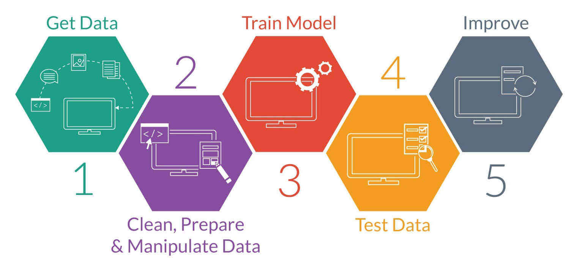
MACHINE LEARNING AND DEEPLEARNING
Machine learning (ML) is the study of computer algorithms that can improve automatically through experience and by the use of data. It is seen as a part of artificial intelligence. Machine learning algorithms build a model based on sample data, known as "training data", in order to make predictions or decisions without being explicitly programmed to do so.
Deep learning (also known as deep structured learning) is part of a broader family of machine learning methods based on artificial neural networks with representation learning. Learning can be supervised, semi-supervised or unsupervised.

Slide 5
NEURAL NETWORKS
A neural network is a network or circuit of neurons, or in a modern sense, an artificial neural network, composed of artificial neurons or nodes.The connections of the biological neuron are modelled in artificial neural networks as weights between nodes. A positive weight reflects an excitatory connection, while negative values mean inhibitory connections. All inputs are modified by weight and summed. This activity is referred to as a linear combination. Finally, an activation function controls the amplitude of the output. For example, an acceptable range of output is usually between 0 and 1, or it could be −1 and 1

Slide 6
CONVOLUTIONAL NEURAL NETWORKS
A convolutional neural network, or CNN, is a deep learning neural network designed for processing structured arrays of data such as images. Convolutional neural networks are widely used in computer vision and have become the state of the art for many visual applications such as image classification.Convolutional neural networks are very good at picking up on patterns in the input image, such as lines, gradients, circles, or even eyes and faces. It is this property that makes convolutional neural networks so powerful for computer vision. Unlike earlier computer vision algorithms, convolutional neural networks can operate directly on a raw image and do not need any pre-processing.

Slide 7
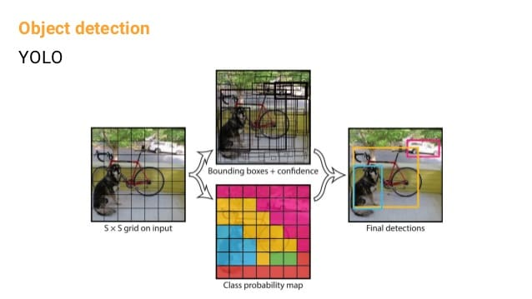
YOLO ALGORITHM
YOLO - You Only Look Once is an algorithm proposed by Redmond et. al in a research article published at the IEEE/CVF Conference on Computer Vision.Compared to the approach taken by object detection algorithms before YOLO, which repurpose classifiers to perform detection, YOLO proposes the use of an end-to-end neural network that makes predictions of bounding boxes and class probabilities all at once.Following a fundamentally different approach to object detection, YOLO achieves state-of-the-art results beating other real-time object detection algorithms by a large margin.

Slide 8
IMPLEMENTATION
Setting neural network
02
Creating blob
03
Getting boxes and confidences
04
Adding bounding boxes to objects
05
Importing libraries and files
01
Saving final image
06

Slide 9
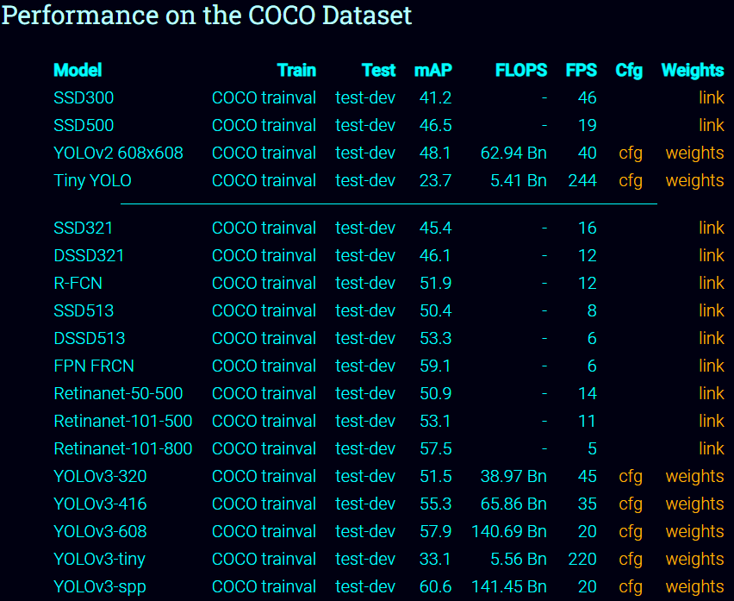
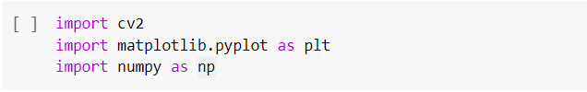
Importing libraries and files
1.Downloading YOLOv3-tiny weights and configuration file from yolo website and coco dataset from its website.
2.Importing cv2,matplotlib,numpy

Slide 10
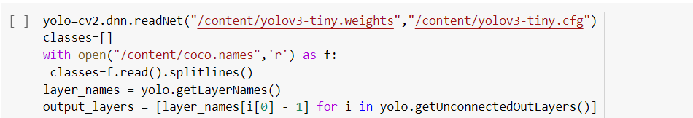
Setting neural network
1.In the first line we are using opencv's dnn module to setup the neural network with pretrained weights and configuration of of YOLO.
2.In the third line we are using 'coco.names' file for getting names of different classes and storing them in 'classes' list.
3.In the fifth line we are extracting names of all the layers of the network and then we are storing the last layers of the network in 'output_layers' by using 'getUnconnectedOutLayers()'.

Slide 11
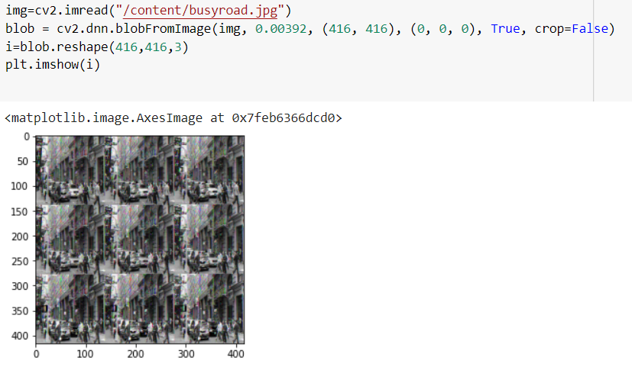
Creating blob
In the context of deep learning and image classification, these preprocessing tasks normally involve: Mean subtraction ,Scaling by some factor And optionally channel swapping.
blobFromImage creates 4-dimensional blob from image. Optionally resizes and crops image from center, subtract mean values, scales values by scalefactor, swap blue and red channels.

Slide 12
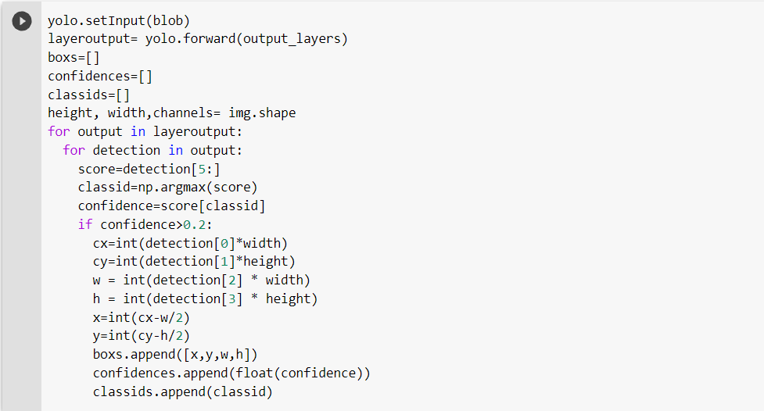
Getting boxes and confidences
1. In the first line we input the blob to the network.
2.In the second line we get the output array of our detection.
3.Under the for loop we get the score(i.e confidence array ) for objects in image,its class,and its width, height and centre coordinate.
4. Then we check if confidence is >0.2 then we add that object in our respective arrays.

Slide 13
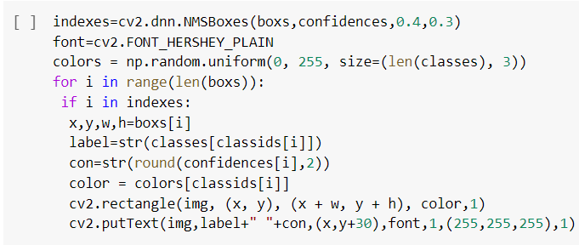
Adding bounding boxes to objects
In this step we add boxes and names to the objects detected in image using rectangle and putText functions. The Non Maximum Suppression is controlled by the nmsThreshold parameter in cv2.dnn.NMSBoxes() function. If nmsThreshold is set too low, e.g. 0.1, we might not detect overlapping objects of same or different classes. But if it is set too high e.g. 1, then we get multiple boxes for the same object. So I have used an intermediate value of 0.3 in our code.

Slide 14
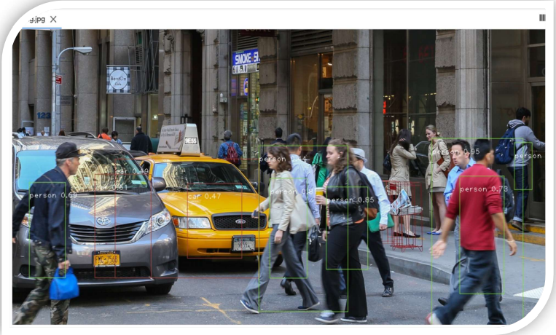
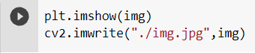
Saving final image

Slide 15
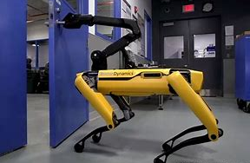
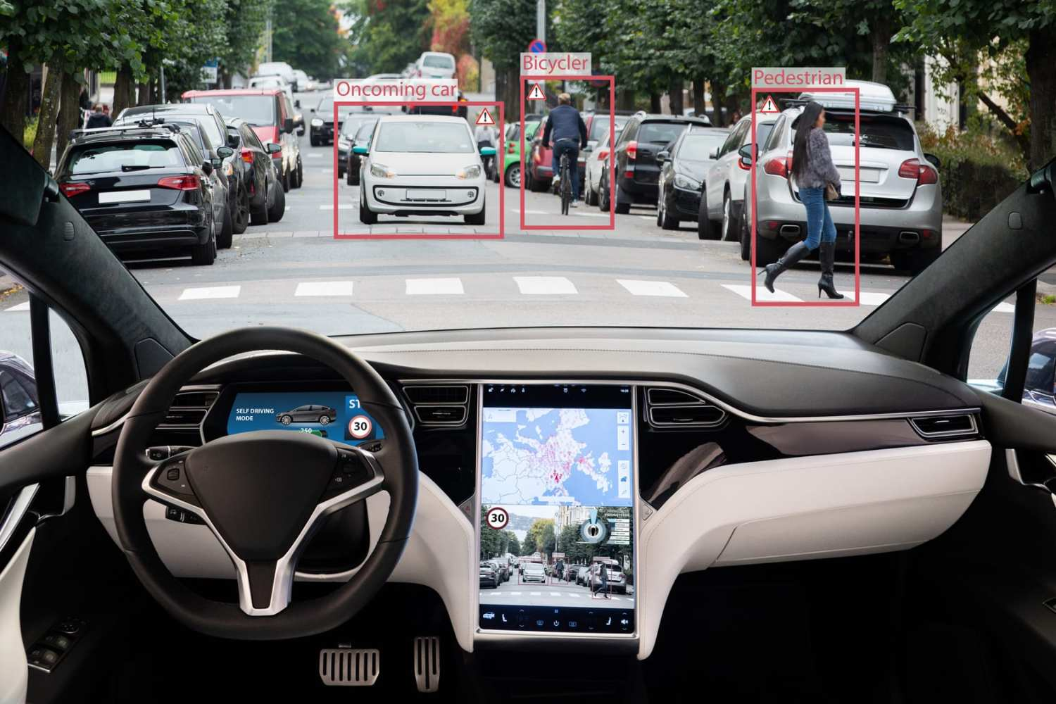
CONCLUSION AND FUTURE SCOPE
With the increase in efficiency of object detection due to advanced technologies, object detection will play a vital role in the manufacturing of self-driving cars in the near future. Other fields include image retrieval, security, surveillance, automated vehicle systems, and machine inspection (such as used in SPOT dog)

